Slide 1
The history of airplane

Slide 2
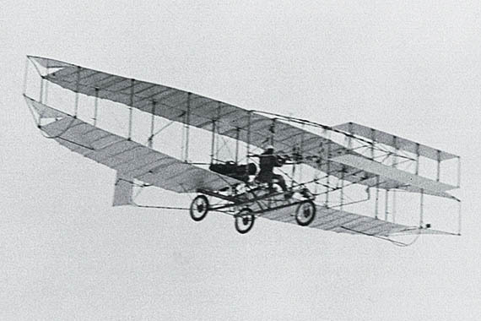
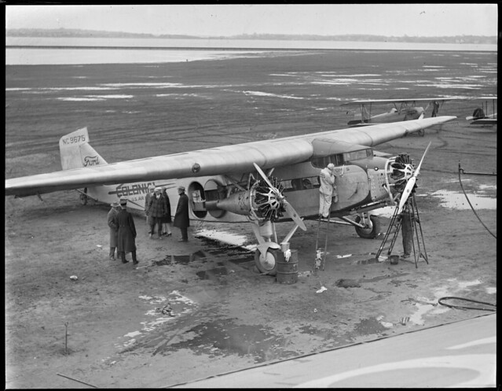
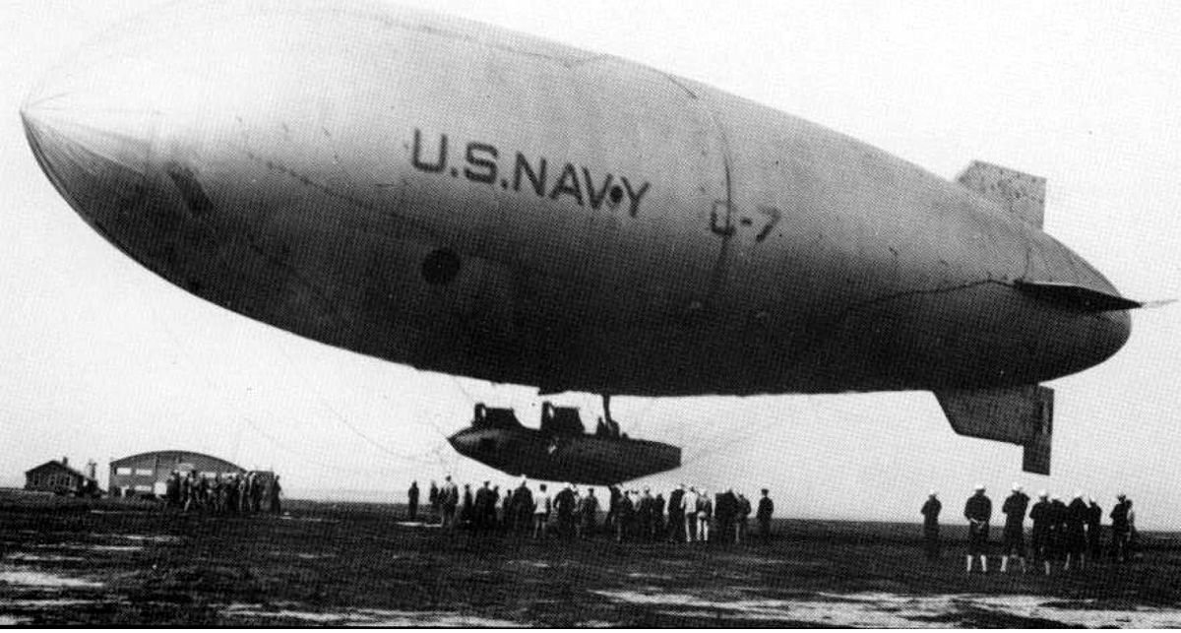
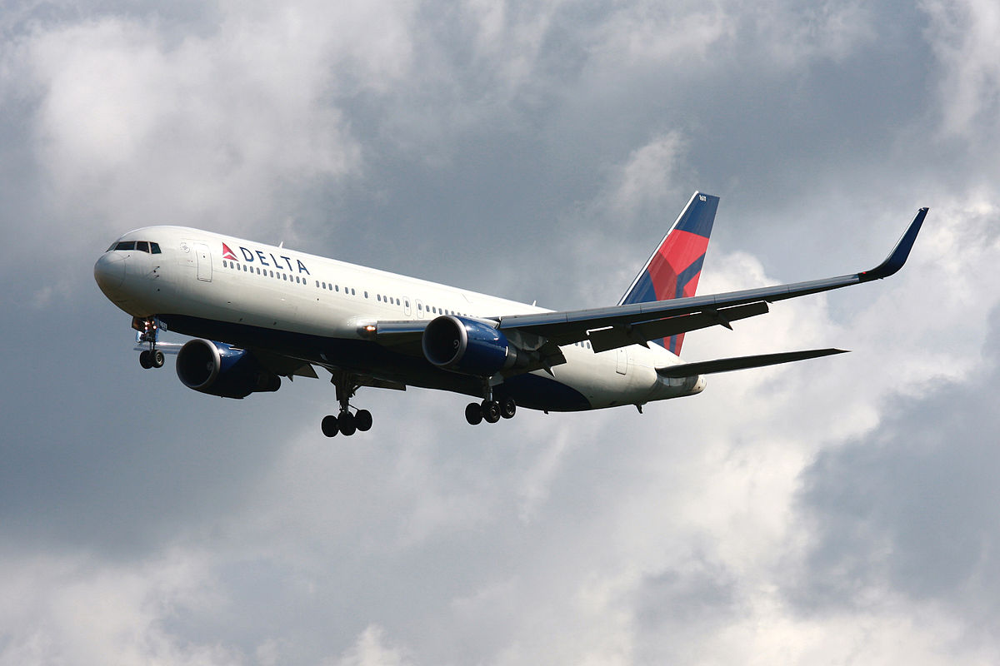
AIRPLANES
First airplane/glider
first passenger plane
first passenger plane
And now
Deze foto van Onbekende auteur is gelicentieerd onder CC BY-SA
Invented by the Wright brothers
Made in 1920
Made in 1930
Made in 2010
Made in 1903

Slide 3
The history
The first airplane was made by the Wright brothers. It was a glider with an homemade engine.
Later other people tried to make it stronger with steel plates. In this way they created the first pasenger plane.
After that they tried to get rid of the engine and put a hot air baloon on top and made the old famous blimp.
After a big accident they threw the idea away and made the normal plane
Nawadays the biggest plane is the A380. They call it the airbus that can fit 853 passengers.

