Slide 1
LIGHT BULB
Thomas Alva Edison. Was the creator of the light bulb.

Slide 2
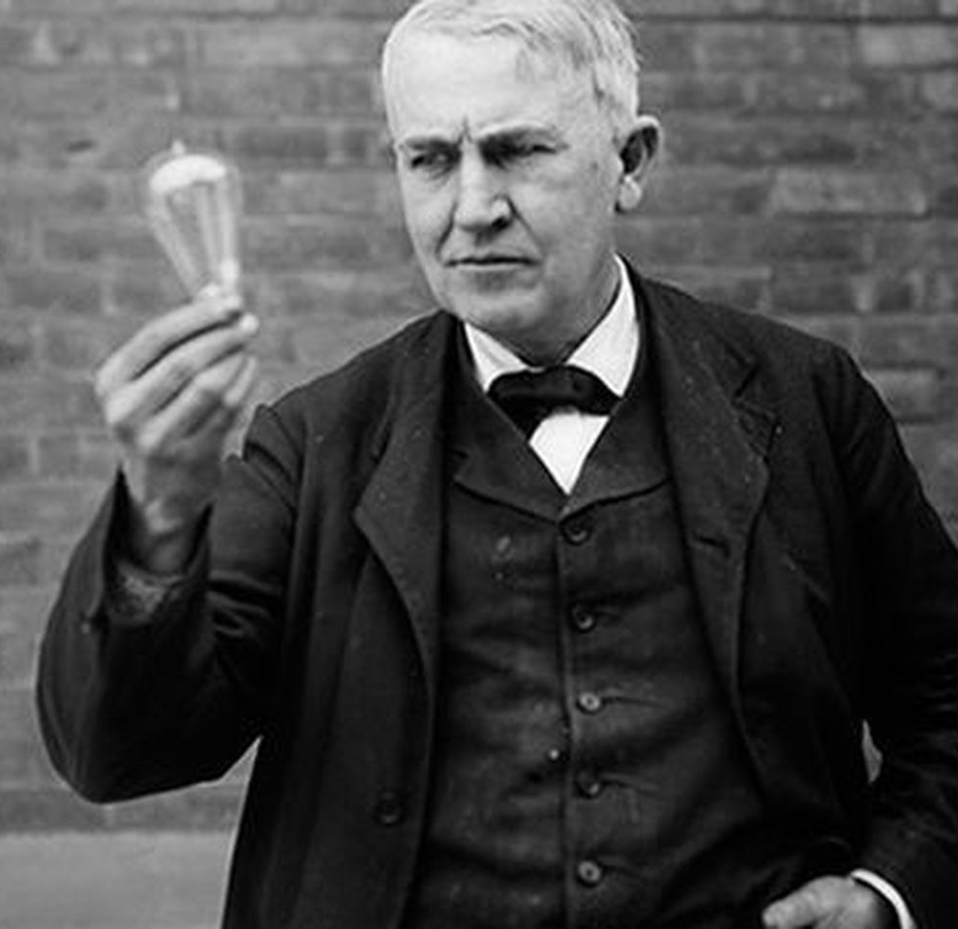
THE TIMELINE OF THE LIGHT BULB
In 1879 Edison presents the first light bulb.
In 1880 Edison patent the light bulb.
In 1881 it was created the first company that produces light bulbs.

Slide 3
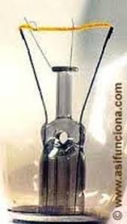
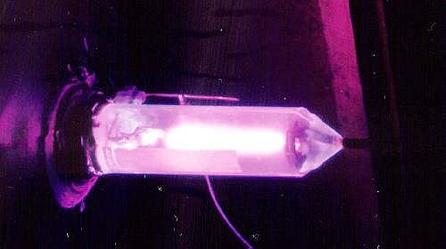
In 1907. Is created the light bulb whith tungsten filament.
In 1913. Introducion of gases in the light bulb.
In 2009. European Union directive set a deadline for member states to stop manufacturing and marketing incandescent lamps.

Slide 4
In 2010. Is forbiten the manufactorig and distribution of the lamps 75w.
In 2011. Is forbiten the manufactorig and distribution of the lamps 60w.
In 2012. Is forbiten the and manufactorig distribution of the lamps 45w and 25w.

Slide 5
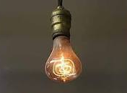
DID YOU KNOW:
The oldest light bulb of the world. Has been wearing without interruptions of 1901 and just completed its first 110 years of service. Is tract a light bulb of 60 watios, blowed to hand, whith carbon filament, and the light is in the firehouse number 6 in Livermore, California.

